Slide 1
Introduction to
Operations Management

Slide 2
Learning Objectives
Define the term operations management
Identify the three major functional areas of organizations and describe how they interrelate
Compare and contrast service and manufacturing operations
Describe the operations function and the nature of the operations manager’s job
1-<number>

Slide 3
Learning Objectives
Differentiate between design and operation of production systems
Describe the key aspects of operations management decision making
Briefly describe the historicalevolution of operations management
Identify current trends that impact operations management
1-<number>

Slide 4
Operations Management
Operations Management is:
The management of systems or processes
that create goods and/or provide services
Operations Management affects:
  Companies’ ability to compete
  Nation’s ability to compete internationally
1-<number>

Slide 5
The Organization
Figure 1.1
The Three Basic Functions
Organization
Finance
Operations
Marketing
1-<number>

Slide 6
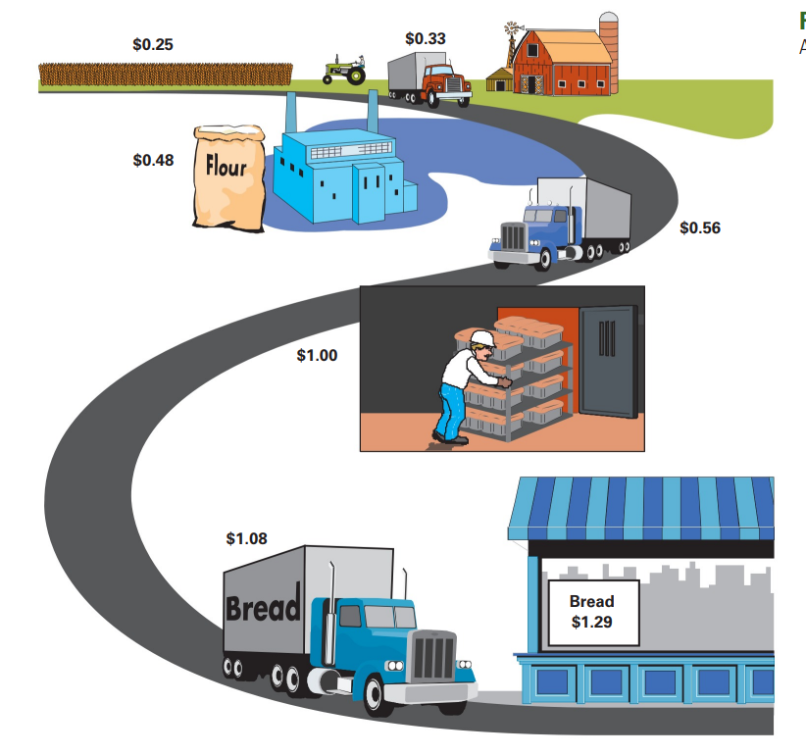
SUPPLY CHAIN OF BREAD
1-<number>

Slide 7
A Supply Chain for Bread
Stage of Production | Value Added | Value of Product
Farmer produces and harvests wheat | $0.15 | $0.15
Wheat transported to mill | $0.08 | $0.23
Mill produces flour | $0.15 | $0.38
Flour transported to baker | $0.08 | $0.46
Baker produces bread | $0.54 | $1.00
Bread transported to grocery store | $0.08 | $1.08
Grocery store displays and sells bread | $0.21 | $1.29
Total Value-Added | $1.29
1-<number>

Slide 8
Value-Added Process
Figure 1.2
The operations function involves the conversion of inputs into outputs
Value added
Inputs
Transformation/
Outputs
Land
Conversion
Goods
Labor
process
Services
Capital
Feedback
Control
Feedback
Feedback
1-<number>

Slide 9
Value-Added & Product Packages
Value-added is the difference between the cost of inputs and the value or price of outputs.
Product packages are a combination of goods and services.
Product packages can make a company more competitive.
1-<number>

Slide 10
Goods-service Continuum
Figure 1.3
Goods
Service
Surgery, teaching
Song writing, software development
Computer repair, restaurant meal
Automobile Repair, fast food
Home remodeling, retail sales
Automobile assembly, steel making
1-<number>

Slide 11
Food Processor
Table 1.2
Inputs
Processing
Outputs
Raw Vegetables
Cleaning
Canned
vegetables
Metal Sheets
Making cans
Water
Cutting
Energy
Cooking
Labor
Packing
Building
Labeling
Equipment
1-<number>

Slide 12
Hospital Process
Table 1.2
Inputs
Processing
Outputs
Doctors, nurses
Examination
Healthy
patients
Hospital
Surgery
Medical Supplies
Monitoring
Equipment
Medication
Laboratories
Therapy
1-<number>

Slide 13
Manufacturing or Service?
Tangible
Act
1-<number>

Slide 14
Production of Goods vs. Delivery of Services
Production of goods – tangible output
Delivery of services – an act
Service job categories
  Government
  Wholesale/retail
  Financial services
  Healthcare
  Personal services
  Business services
  Education
1-<number>

Slide 15
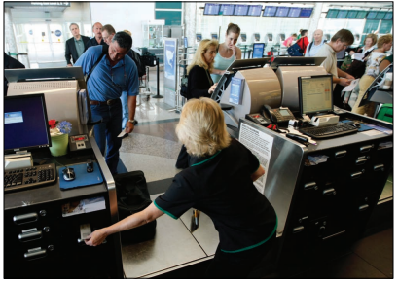
Key Differences
1. Customer contact
2. Uniformity of input
3. Labor content of jobs
4. Uniformity of output
5. Measurement of productivity
1-<number>

Slide 16
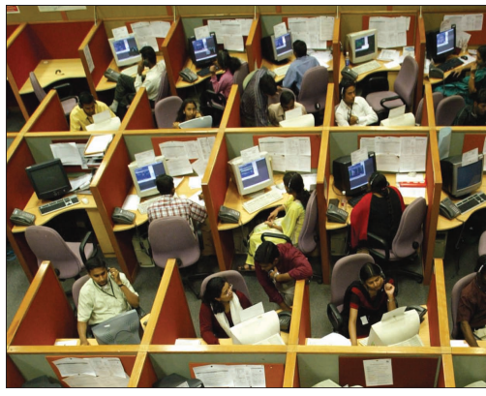
Key Differences
6. Production and delivery
7. Quality assurance
8. Amount of inventory
9. Evaluation of work
10. Ability to patent design
1-<number>

Slide 17
Goods vs Service
Characteristic | Goods | Service
Customer contact | Low | High
Uniformity of input | High | Low
Labor content | Low | High
Uniformity of output | High | Low
Output | Tangible | Intangible
Measurement of productivity | Easy | Difficult
Opportunity to correct problems | High | Low
Inventory | Much | Little
Evaluation | Easier | Difficult
Patentable | Usually | Not usual
1-<number>

Slide 18
Types of Operations
Table 1.4
Operations
Examples
Goods Producing
Farming, mining, construction
,
manufacturing, power generation
Storage/Transportation
Warehousing, trucking, mail
service, moving, taxis, buses,
hotels, airlines
Exchange
Retailing, wholesaling, banking,
renting, leasing, library, loans
Entertainment
Films, radio and television,
concerts, recording
Communication
Newspapers, radio and television
newscasts, telephone, satellites
1-<number>

Slide 19
Simple Product Supply Chain
Figure 1.7
Suppliers’ Suppliers
Direct
Suppliers
Final
Consumer
Producer
Distributor
Supply Chain: A sequence of activities
And organizations involved in producing
And delivering a good or service
1-<number>

Slide 20
Contemporary IT- enabled manufacturing operations
Robotics
Nanotechnology
3D printing
The internet of things
Cloud Computing
1-<number>

